Slide 1
Reinforcement Learning in Monopoly Through Three Q-learning Variants
By Albert Jing, Dake Peng, Paul Claudel Izabayo, and Xiaoying Qu
Notes:
Albert

Slide 2
Roadmap
Monopoly: Game Logistics
Reinforcement Learning & Q-Learning
3 Variants of Q-Learning
Implementation Details
Results
Notes:
Xiaoying

Slide 3
The Game
Notes:
xiaoying

Slide 4
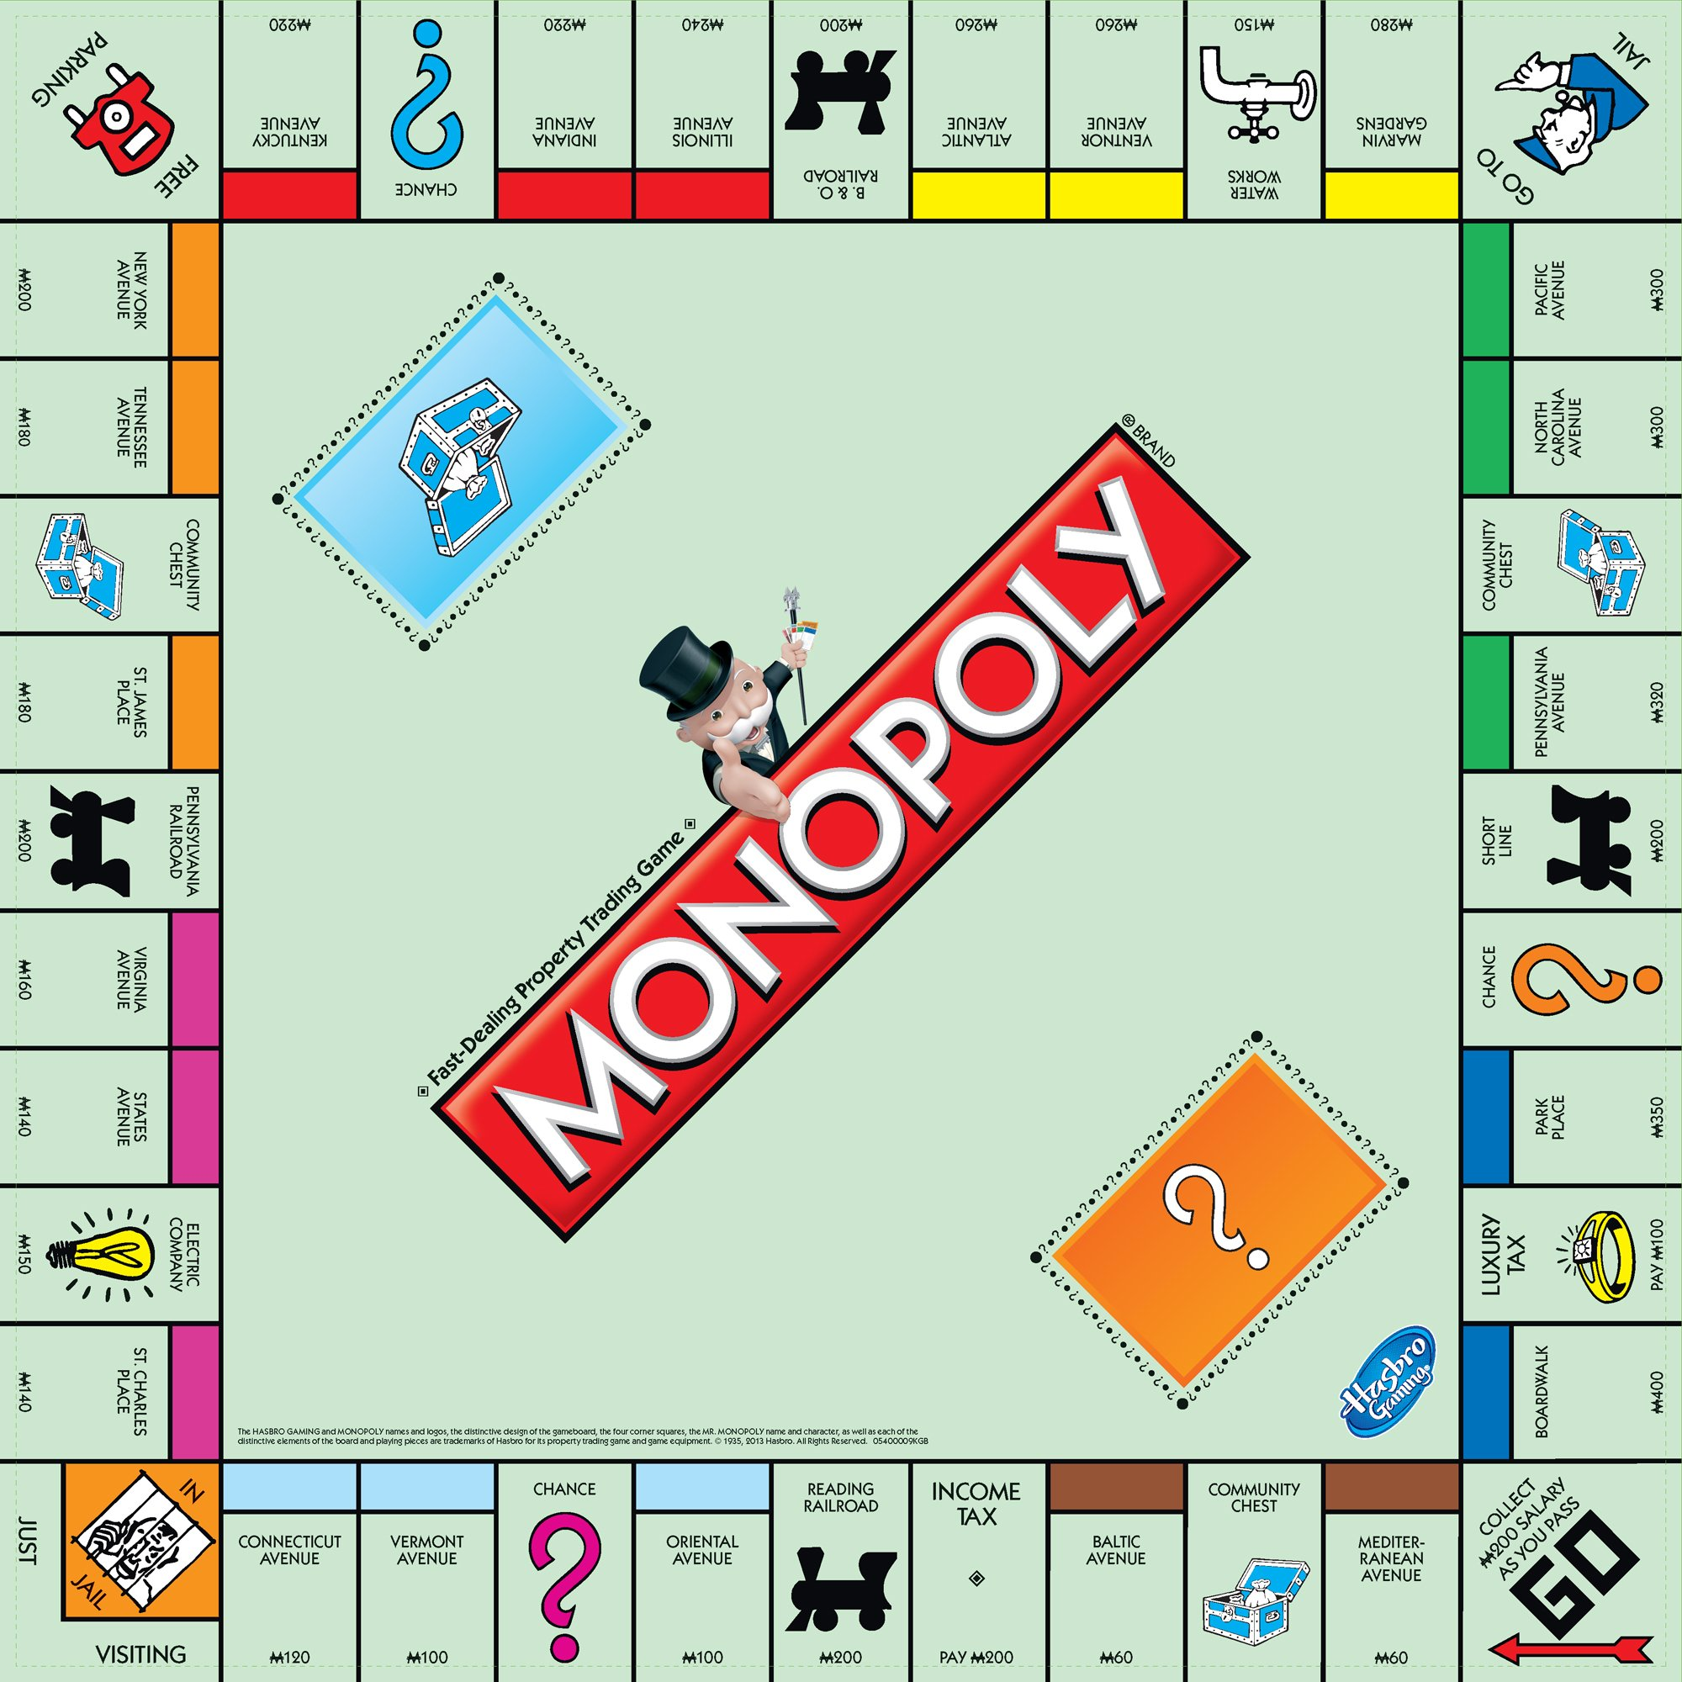
Components
a Monopoly board
two dice
12 game tokens
32 houses and 12 hotels
16 Chance cards and 16 Community Chest cards
A title deed card for each property
Monopoly money
Notes:
Xiaoying

Slide 5
How to play?
Objective
Gameplay
Trading and Building
Winning

Slide 6
The Algorithm
Notes:
Dake

Slide 7
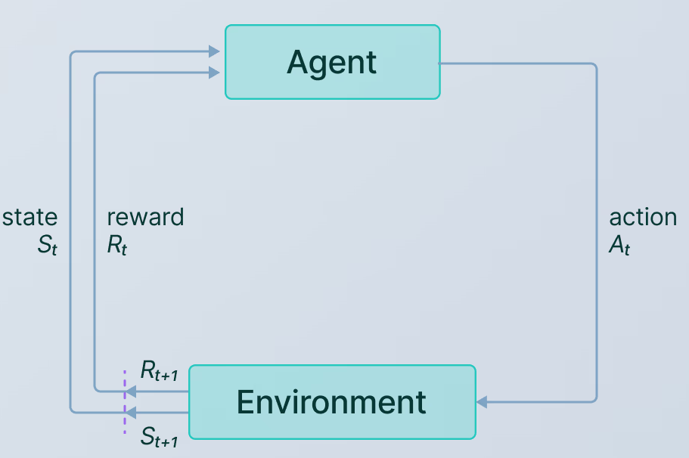
Reinforcement Learning
State: how much money/houses/property do I own, as compared to others? Where am I?
Action: should I buy (houses/property), sell, or do nothing?
Reward: based on the action taken, did my situation improve? (do I have more money/houses/property than others?)
Notes:
Dake
https://www.v7labs.com/blog/reinforcement-learning-applications
Use pointer

Slide 8
Q Learning
Takes 1 step of either:
Exploration: taking a random action
Or
Exploitation: taking the best action we know
Q-Values
facilitate
ϵ-greedy Exploration
What is the estimated reward of taking a certain action?
update
calculate
Temporal Difference
How off was the estimated reward based on the step taken?
Notes:
Dake
What is a Q value?

Slide 9
Agents: Three Variants
Basic Q Learning
Approximate Q Learning
Deep Q-Lambda Learning
Notes:
Dake

Slide 10
Basic Q-Learning
Q-table
Action
New Q-Value
Buy
Sell
Do Nothing
State
How do we get this value?
Is position a property?
Has
monopoly?
Has more money?
Notes:
Xiaoying

Slide 11
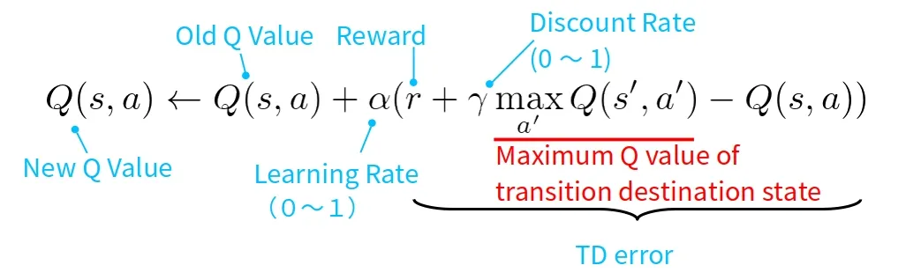
Q-learning algorithm
Why do we care about Greek letters?

Slide 12
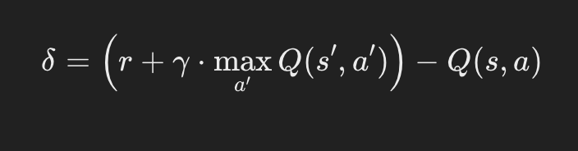
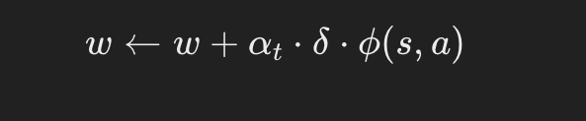
Approximate Q Learning
What Do we Approximate?
How to Approximate?
Temporal Difference Error
Q-values associated with each state-action pair
Why Approximate?
reward
Next Best Q Value
TD Error
Discount Factor
Current Best Q Value
There are way too many state-action pairs to calculate and save a q-value for each one
Updating Weights
Learning Rate
Features
Current Weights
TD Error
Notes:
The Temporal Difference (TD) Error measures how much the Q-value estimate differs from a more updated estimate.
td_error = reward +discount_factor*max_next_q_value*current_q_value
Weights += alpha*td_error*features

Slide 13
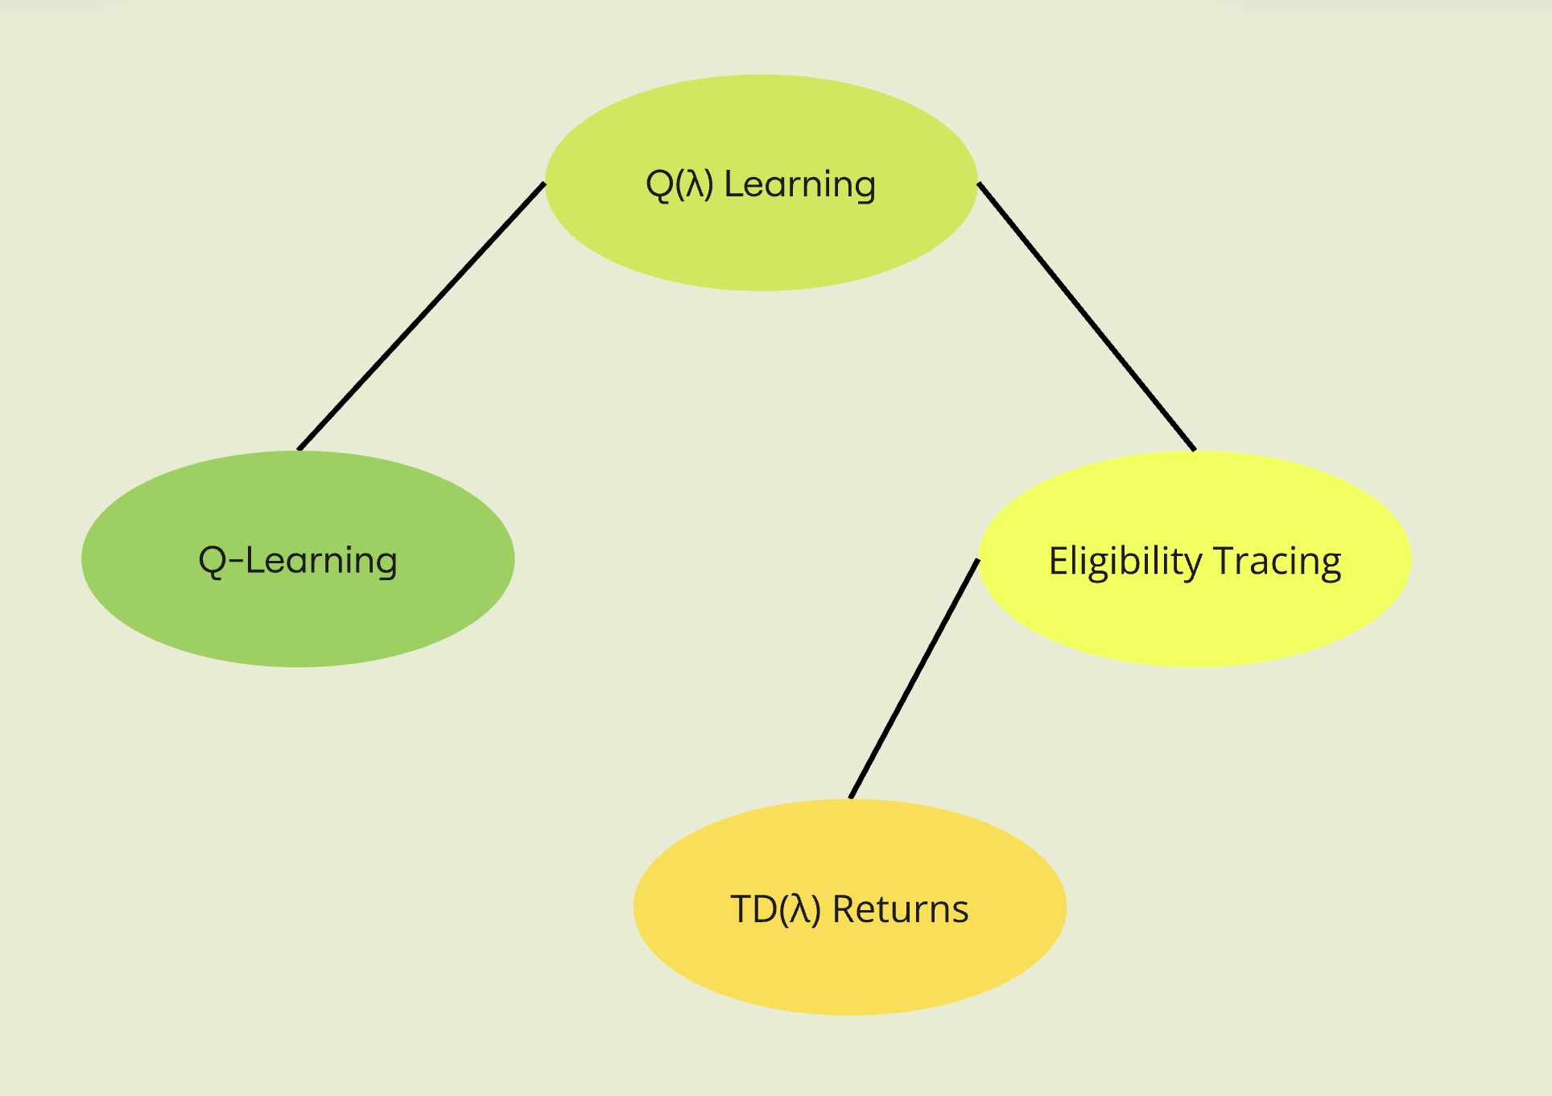
(Deep) Q-Lambda Learning
Like Q Learning… BUT with tracing
Parameter λ acts as decay rate for traces aka how much past actions influence the current update
Recent actions get more credit, older ones less
Neural Network implementation
Notes:
Albert Talk more about tracing and focus on that, also add in the neural net part
Initialize Q(x,a) = 0 and Tr(x,a) = 0 for all states x and actions a
At each time step:
Observe current state x
Select action a (according to exploration policy)
Execute action, observe reward r and next state x'
Calculate TD error: e = r + γ·max_a'Q(x',a') - Q(x,a)
Update activity traces: Tr(x,a) = γ·λ·Tr(x,a)
For all state-action pairs: Q(x,a) += α·e·Tr(x,a)
Increment trace for current state-action: Tr(x,a) += 1

Slide 14
Implementation
Notes:
Paul

Slide 15
Game Environment (Python Engine)
Board
Dice
Player
Player Logistics
Game
Settings
Monopoly Game Simulator
Notes:
Paul

Slide 16
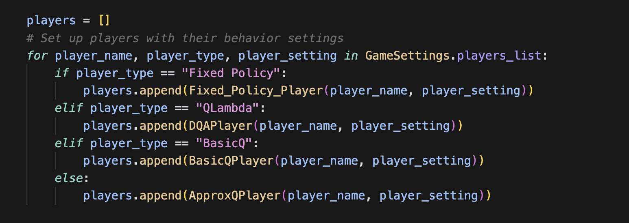
Modifications to the Game for RL
Expansion of player types
Add player_logistic.py to handle fixed-policy action and player.py for agent-specific logic
Added BasicQ, ApproxQ, and QLambda player type
In game.py
Notes:
Xiaoying

Slide 17
Training Cycle
Init Model
Extract Features
Get Q Values
?
?
Update Model
Explore
Exploit
Get Reward
Next State
Execute Action
Choose Action
Notes:
Paul

Slide 18
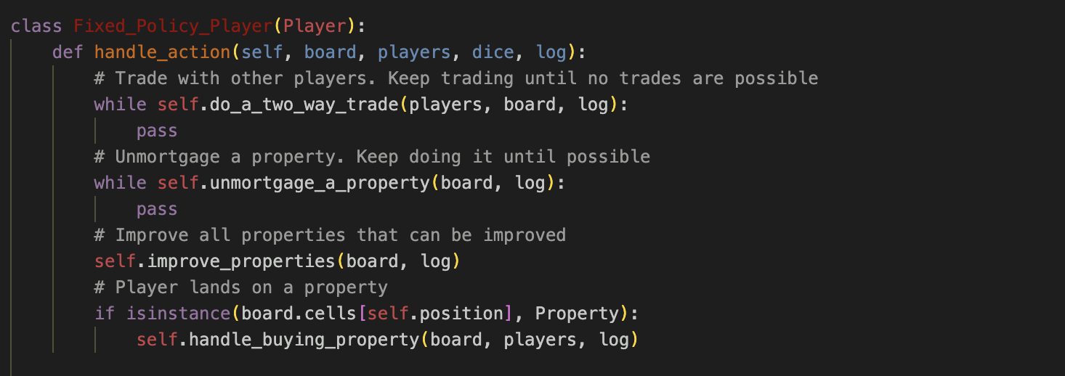
Fixed Policy (FP) Agent
Q-learning agents are trained against a rule-based, not adaptive, Fixed Policy Agent
Proposes trading, mortgaging/unmortgaging property, upgrading property and buying property.
Differences of Fixed Policy vs. Q-learning Agents:
Performs actions regardless of color group
Buys more aggressively
Provides lists for potential buys and sells for trading & proposes trades
Notes:
Albert Add in what it does based on fixed policy code

Slide 19
Results
Notes:
Dake

Slide 20
Evaluation Method
Performance:
win rate and survival rate in a 1000 game simulation
Stabilization of the agent:
Is the win rate/survival rate consistent over time (i.e. with more training)?
Logging Q values for a set of test states, have they stabilized?
Logging rewards the agent received & choices that the agent made
Notes:
Dake
We play a number of turns, and if it comes to a draw it survives

Slide 21
Training Results
 | Basic Q | Approximate Q | Deep Q-Lambda
Training Condition | 2 players Trading Disabled Long games (1,000 rounds) | 2 Players Trading Disabled Long Games (1,000 rounds) | 4 Players FP-based Trading Short Games (100 rounds)
# Games to Stabilize | ~180 | ~750 | ~700
Survival Rate Against Fixed Policy Agent (Under the training condition) | Random: 17.5% BasicQ Agent: 54.8% FP Agent: 66% | Random: 17.5% ApproxQ Agent: 65% FP Agent: 66% | Random: 20% DQL Agent:40% FP Agent: 60%
Notes:
Dake

Slide 22
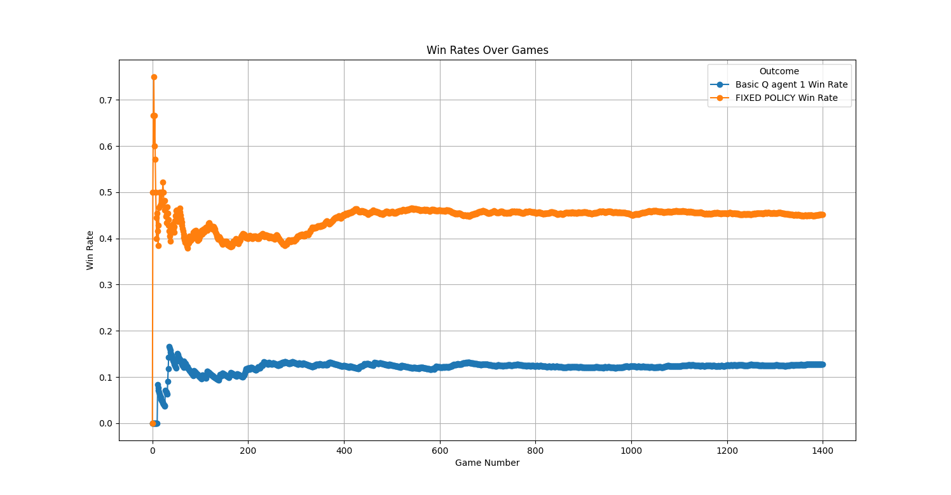
Training Session - Basic Q Learning Agent
(1 Basic Q Agent vs. 1 Fixed Policy Player; No trading; Long games)
Notes:
Xiaoying

Slide 23
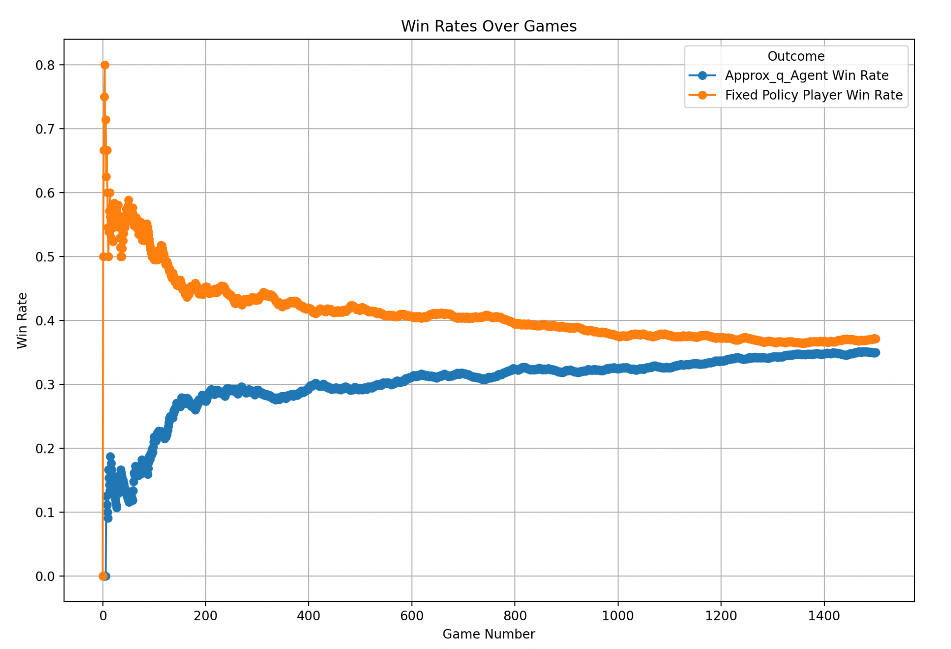
Training Session - Approx Q Learning Agent
(1 Approx Q Agent vs. 1 Fixed Policy Player; No trading; Long games)
Notes:
Paul

Slide 24
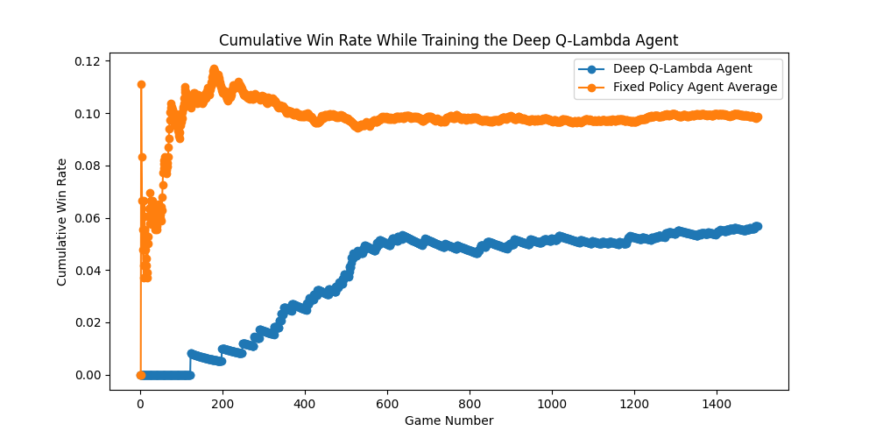
Training Session - Deep Q Lambda Agent
(Q-Lambda Agent vs. 3 Fixed Policy Players; Fixed-Policy trading; Short games)
Notes:
Dake
Learning, Stabilized; not beating; future work

Slide 25
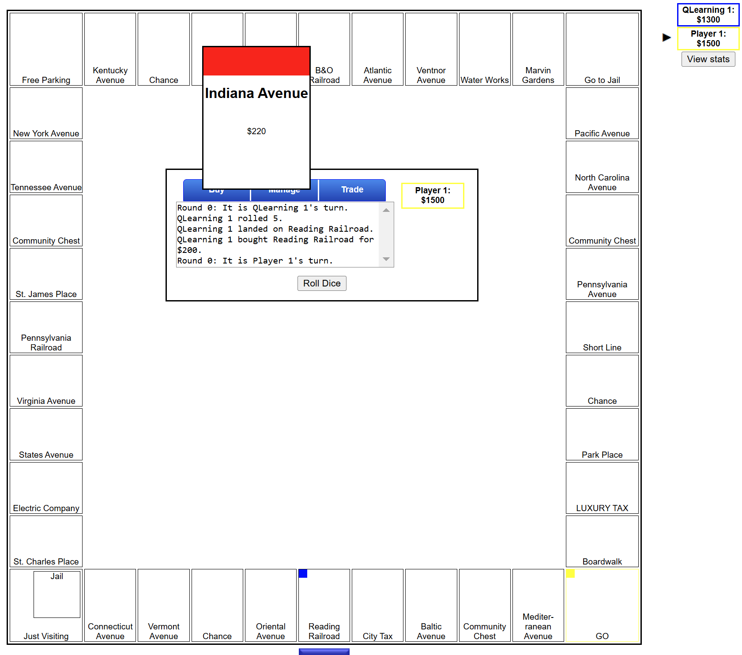
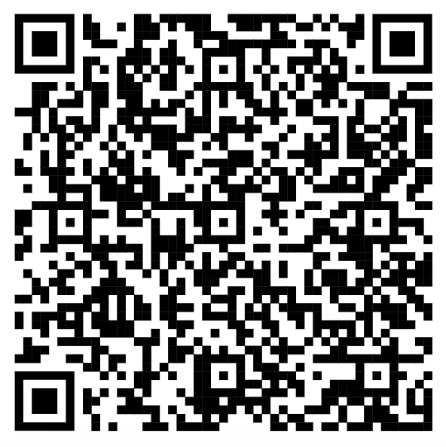
Web Integration
Our Deep-Q-Lambda (beta) model was exported and integrated into a Javascript engine (borrowed from intrepidcoder/monopoly), so you can play with it online !
https://comps-monopoly-carletoncsf24.github.io/MonopolyRL/JavaScript%20Engine/
Notes:
Albert

Slide 26
Summary
What We Did
Q - Learning
We implemented 3 types of Q learning agents to play Monopoly: Basic Q Learning; Approximate Q Learning; and Deep Q-Lambda Learning
A reinforcement learning algorithm where the agent keeps q-values (measures of how good actions are) and updates them through exploring the environment.
Results
Web Integration
Our agents:
Stabilized after 600-800 games with fixed policy agents
Performed better than random action.
Play with our Deep Q-Lambda Agent (beta)!

Slide 27
Thank You!❤️
Notes:
The thank you slide stays longer than any other slide.
We should add something that people should be looking at.
Add maybe a summary or a just show the web integration slide which is the previous slide

Slide 28
References
Python Monopoly Engine: (github) gamescomputersplay/monopoly
Basic Q & Deep-Q-Lambda algorithm:
Bailis, P., Fachantidis, A., & Vlahavas, I. (2014). Learning to play monopoly: A reinforcement learning approach. In Proceedings of the 50th Anniversary Convention of The Society for the Study of Artificial Intelligence and Simulation of Behaviour. AISB.
Peng, J., & Williams, R. J. (1994). Incremental multi-step Q-learning. In Machine Learning Proceedings 1994 (pp. 226-232). Morgan Kaufmann.
Deep-Q-Lambda implementation details: (github) pmpailis/rl-monopoly.
JavaScript Engine: (github) intrepidcoder/monopoly

